Slide 1
EST Revision Ecological interactions
Year 12 Integrated science

Slide 2
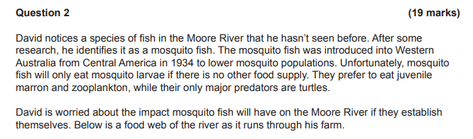
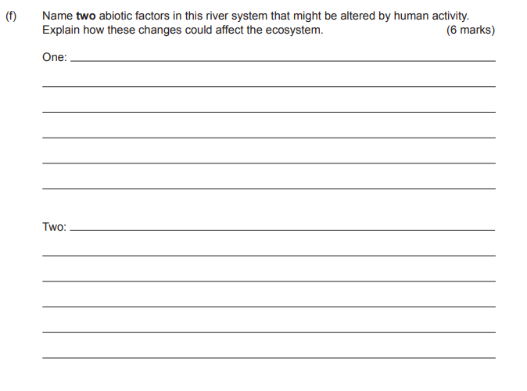

Slide 3
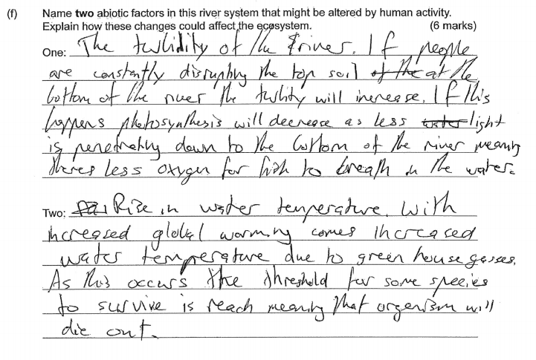
Strong student answer
How many marks do you think they received?
5/6

Slide 4
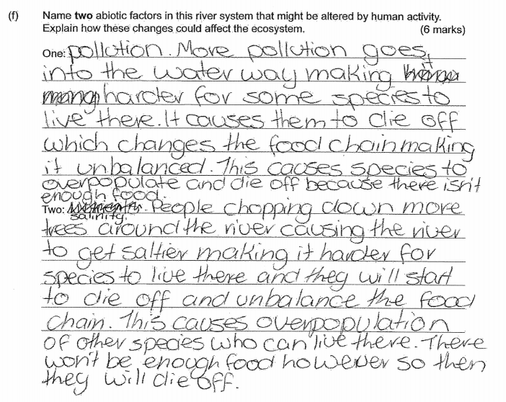
Satisfactory student answer
How many marks do you think they received?
1/6

Slide 5
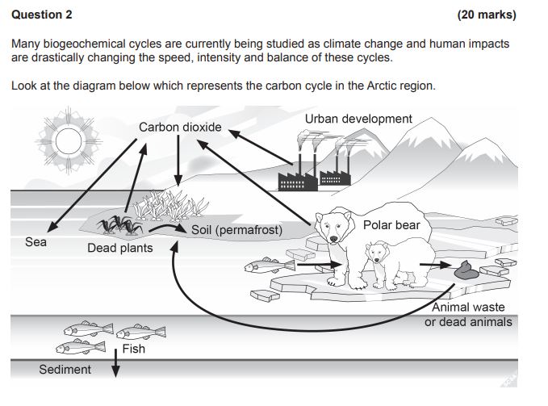
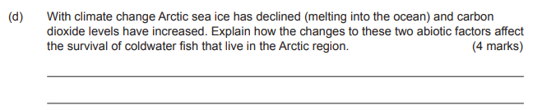

Slide 6
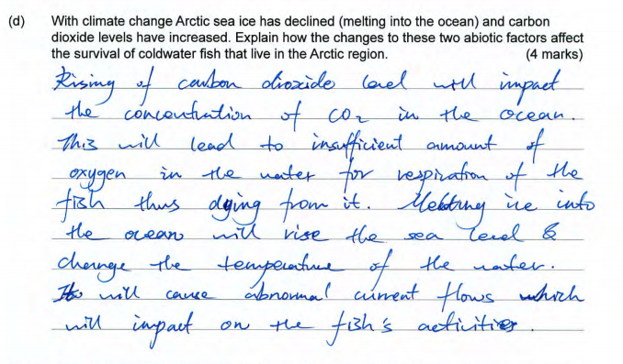
Strong student example
How many marks do you think they received?
2/4
How might they improve their answer?

Slide 7
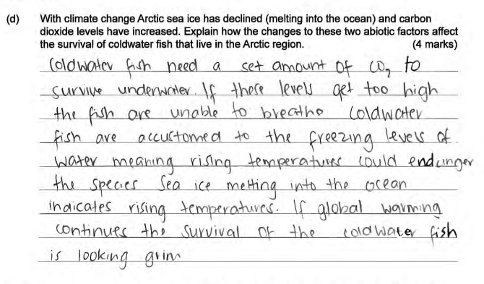
Satisfactory student example
How many marks do you think they received?
2/4

